Slide 1


Slide 2

Image Analysis for Automated Defect Detection

Slide 3
Group Members Introduction
Student Name : Saba Gulam Rasool
Student ID: bc220416292
BSCS(COMPUTER SCIENCE)
7th semester

Slide 4

INTRODUCTION OF PROJECT
This project aims to design and develop an intelligent system that can automatically detect visible surface defects such as cracks, dents, and spalling in industrial pipelines or construction materials using image processing techniques.

Slide 5
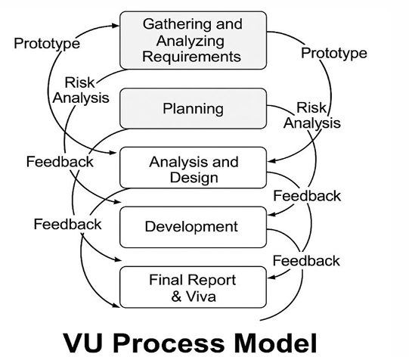

Slide 6
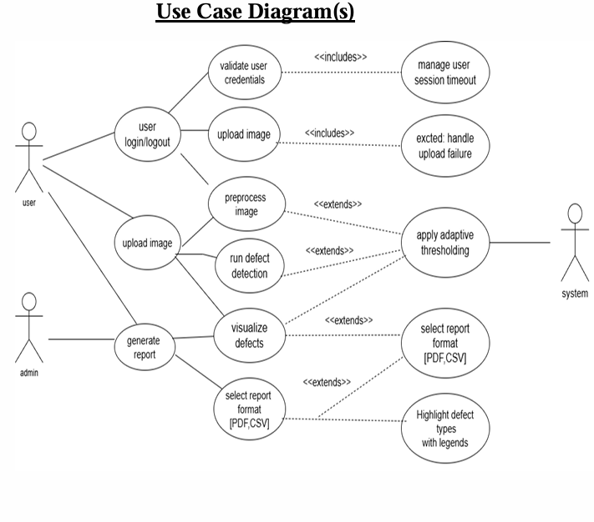
Use Case Diagram

Slide 7
Business Rules Catalog
Functional Requirements
The following are the core functional requirements of the system:
User Authentication
The system shall provide a secure login and logout mechanism to ensure that only authorized users can access the application.

Slide 8
Image Upload Functionality
The system shall allow users to upload images of industrial pipelines or construction surfaces for analysis through a user-friendly interface.
Image Preprocessing
The system shall perform preprocessing on the uploaded images, including resizing, noise removal, and brightness adjustment, to prepare them for accurate defect detection.
Integration with Pretrained Model for Defect Detection
The system shall integrate a lightweight pretrained object detection model (e.g.,
YOLOv4-Tiny) to automatically identify visible defects such as cracks, leaks, dents,
or surface degradation.
Visualization of Detected Defects
The system shall display the results of the analysis by highlighting the detected
defects using bounding boxes or labeled overlays directly on the processed images.

Slide 9
Defect Information Display
The system shall present a summary of the detected defects, including their types,
approximate locations, and quantity for each image.
Automated Report Generation
The system shall generate a report for each processed image, including the uploaded
image, defect details, and total count, and allow users to download or save this report
locally.

Slide 10
Architectural Design

Slide 11
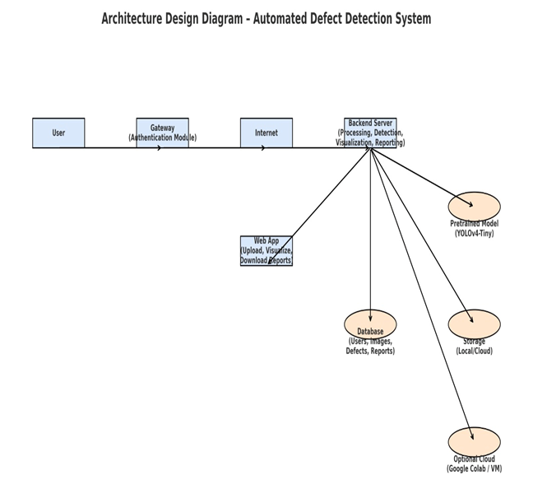

Slide 12
Team Structure
Provide here the diagrammatic view of your team structure and key responsibilities.

Slide 13
Project Schedule
Gantt Chart

Slide 14
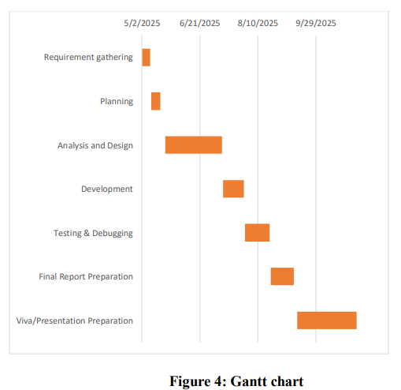

Slide 15
Sequence Diagrams
Provide some core sequence diagrams here. Provide one diagram per slide and give heading at top for each sequence diagram.

Slide 16
Generate Report Sequence

Slide 17
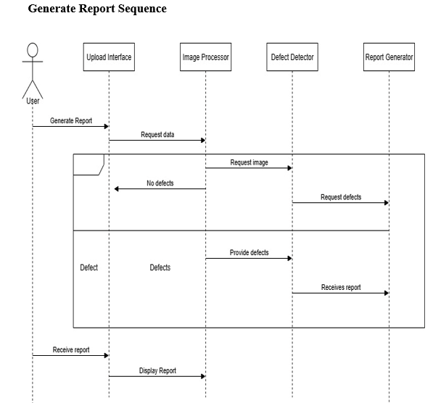

Slide 18
Upload Image Sequence

Slide 19
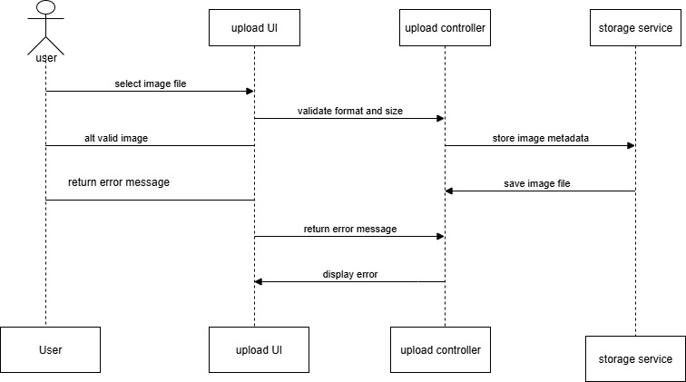

Slide 20
User Registration sequence

Slide 21
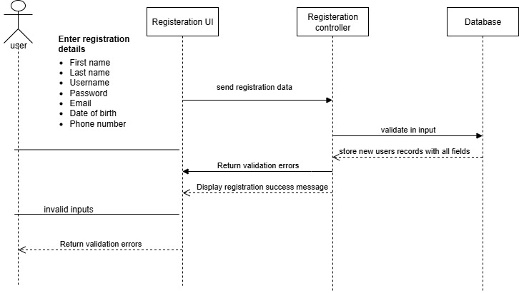

Slide 22
Preprocessing Image Sequence

Slide 23
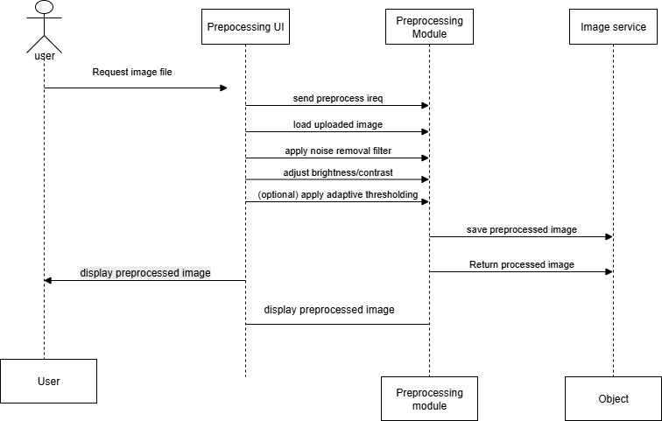

Slide 24
Defect Visualization Sequence

Slide 25
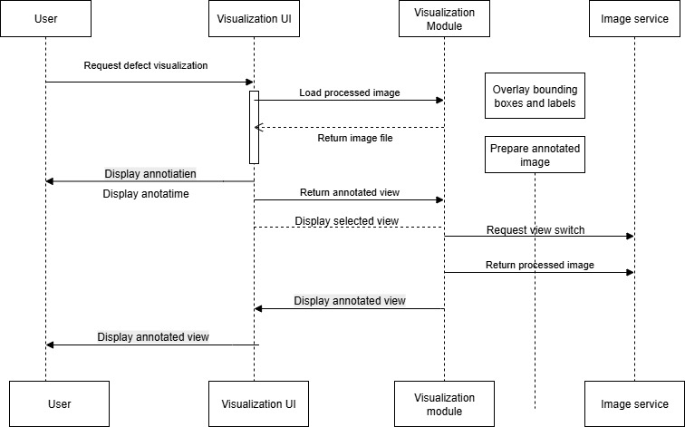

Slide 26
Logical Model/Class Diagram

Slide 27
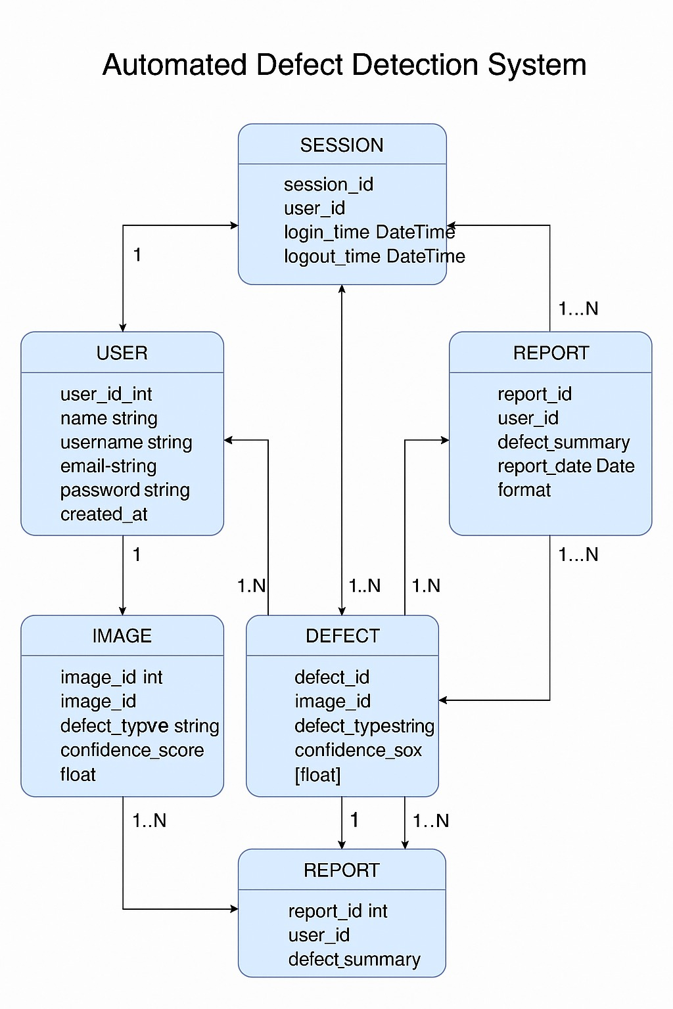

Slide 28
Entity-Relationship Diagram

Slide 29
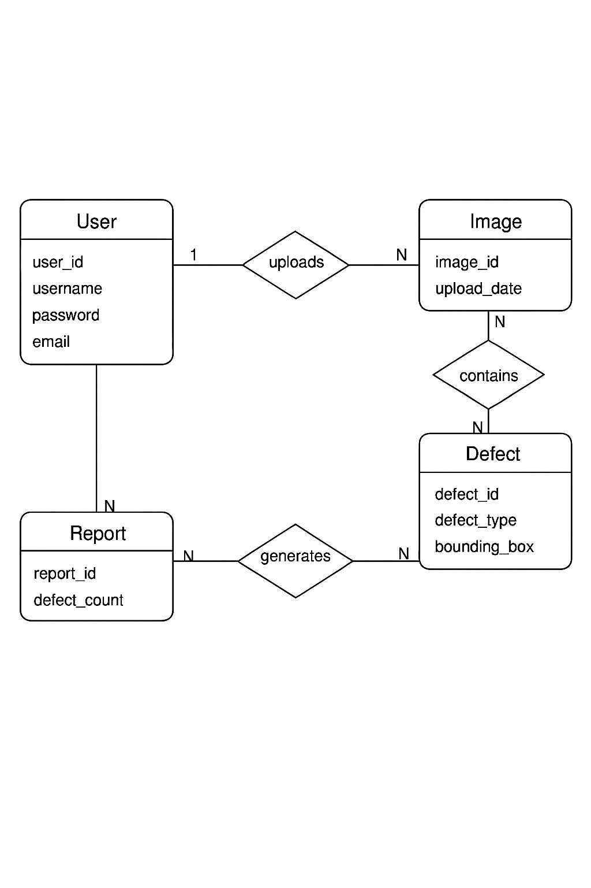

Slide 30
Database Diagram

Slide 31
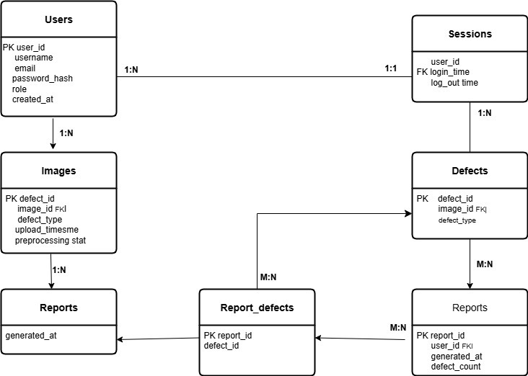

Slide 32
User Interfaces
Provide screen shots of GUI in different slides of your application here

Slide 33
Tools
Write the various tools you have used
during the development of this application

